Slide 1
PERSONALITY PREDICTION THROUGH CV ANALYSIS
-Team Members Balaji Pavan Raghavendra Chatakonda-16341519 Gurudatha Sai Sreekar Nukala-16341712 Dharam Teja Mali-16344665 Abhinaya Pailla-16344740

Slide 2
Presentation Outline
Problem Statement
The Big Five Personality Traits model
Dataset Explanation
Data Cleaning
Data Analysis
Model Training
Resume Parser
GUI
Output Screenshots
References

Slide 3

Problem Statement:
There is a huge workload on the human resource department to select the right candidate for a particular job profile which in turn would provide experts workforce for the organization from a large pool of candidates..

Slide 4
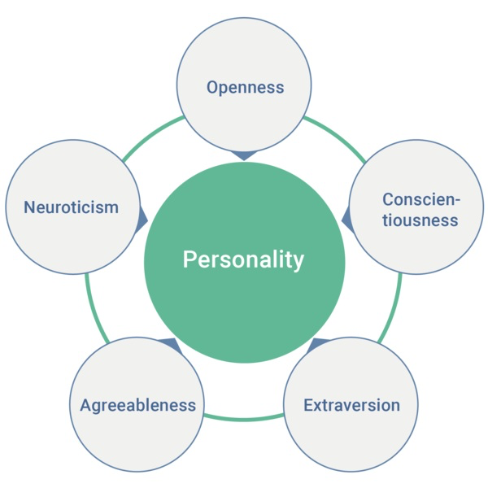
The Big Five Personality Traits model

Slide 5
Openness : People who like to learn new things and enjoy new experiences usually score high in openness. Openness includes traits like being insightful and imaginative and having a wide variety of interests.
Conscientiousness : People that have a high degree of conscientiousness are reliable and prompt. Traits include being organised, methodic, and thorough.
Extraversion : Extraversion traits include being; energetic, talkative, and assertive (sometime seen as outspoken by Introverts). Extraverts get their energy and drive from others, while introverts are self-driven get their drive from within themselves.
Agreeableness : As it perhaps sounds, these individuals are warm, friendly, compassionate and cooperative and traits include being kind, affectionate, and sympathetic. In contrast, people with lower levels of agreeableness may be more distant.
Neuroticism : Neuroticism or Emotional Stability relates to degree of negative emotions. People that score high on neuroticism often experience emotional instability and negative emotions. Characteristics typically include being moody and tense.

Slide 6
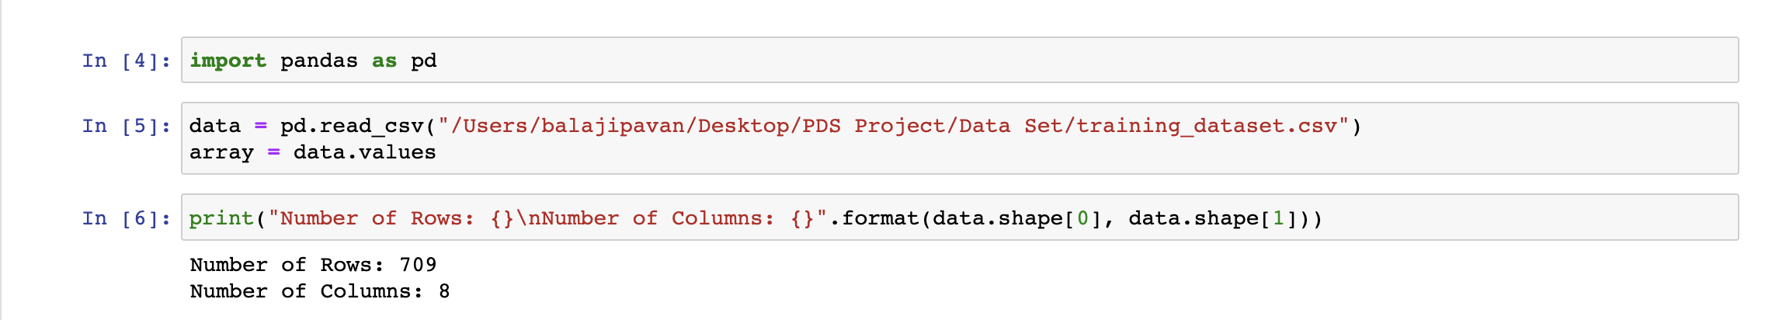
Dataset Explanation
--> We Collected the dataset from Kaggle.com.
--> It contains 8 variables and 709 records.
--> In this dataset we have both categorical and numerical values.

Slide 7
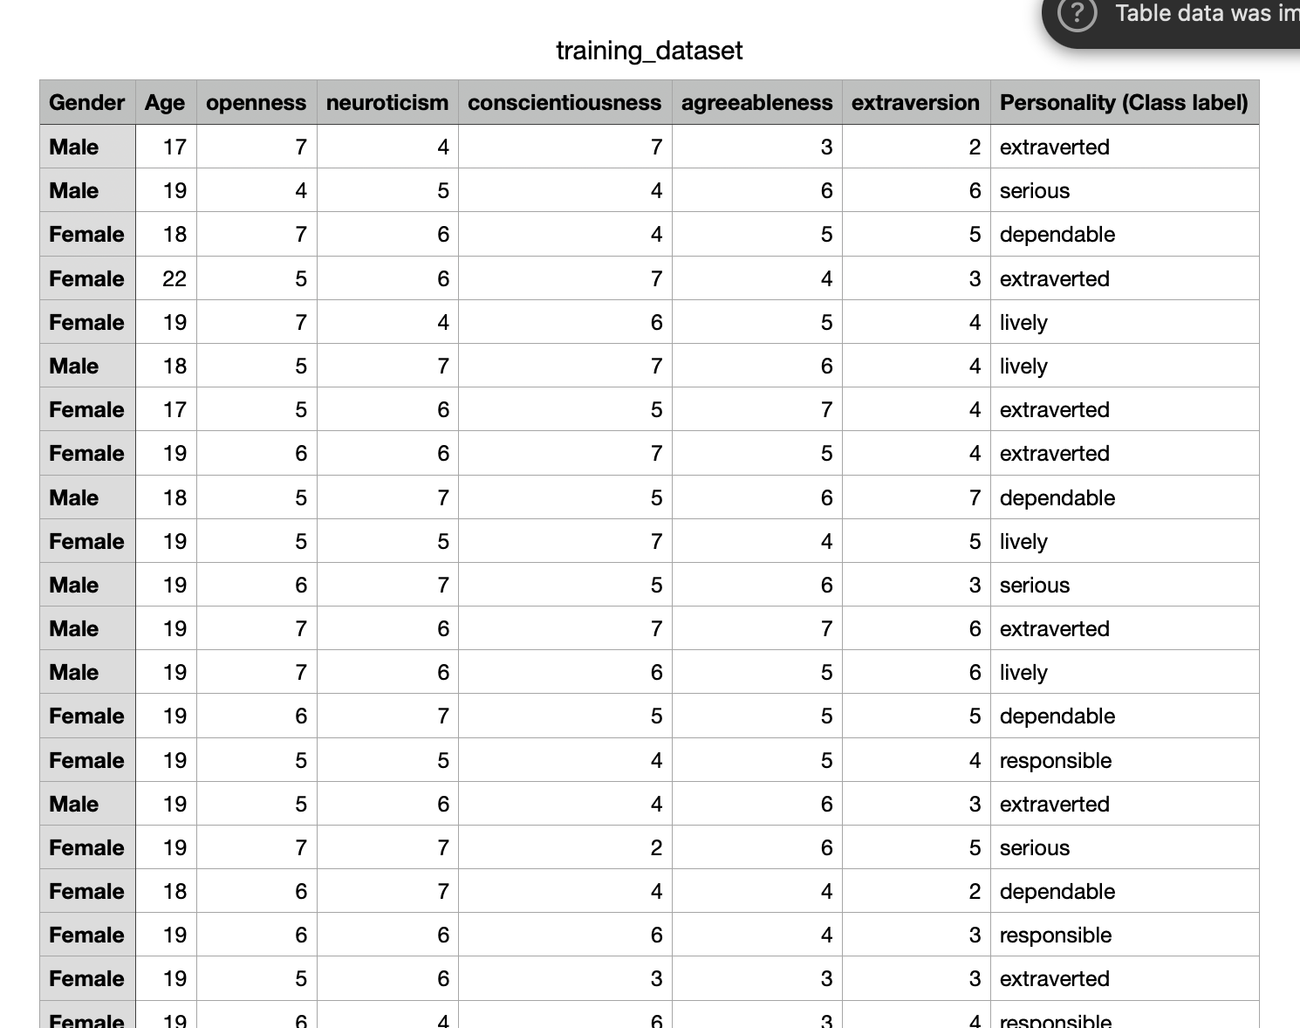

Slide 8
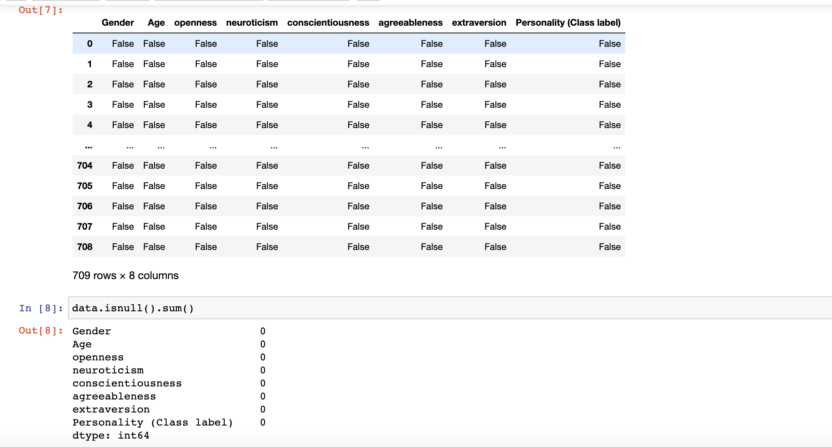
Data Cleaning
Identifying null attributes in the data.
Removed Irrelevant data.

Slide 9
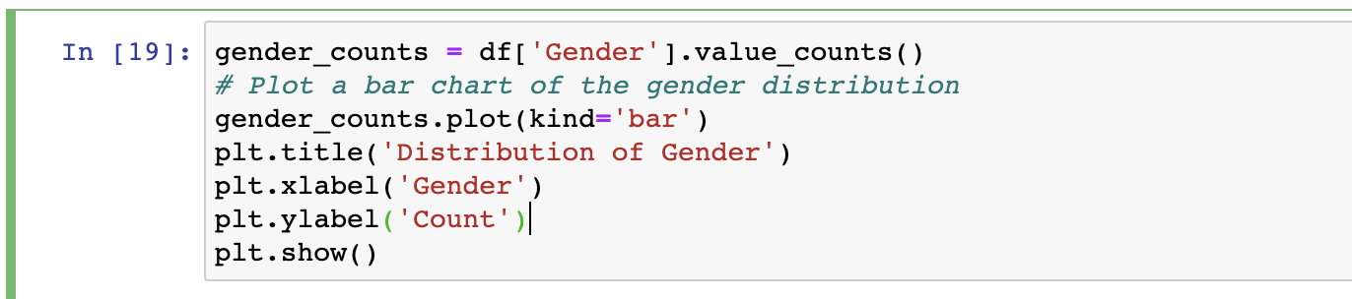
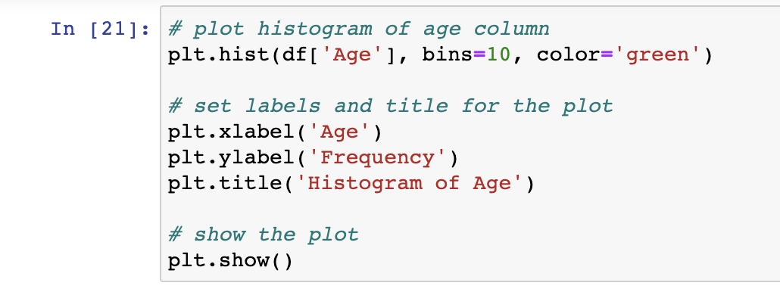
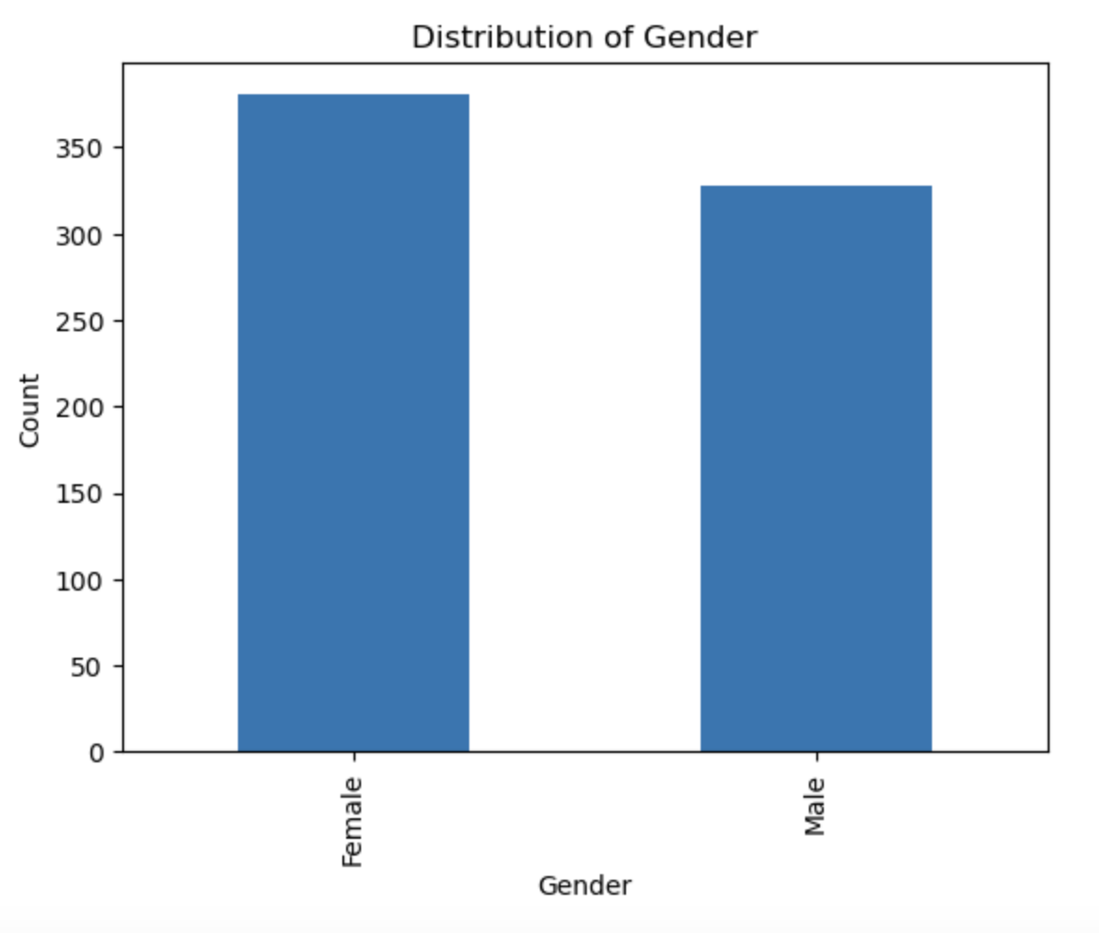
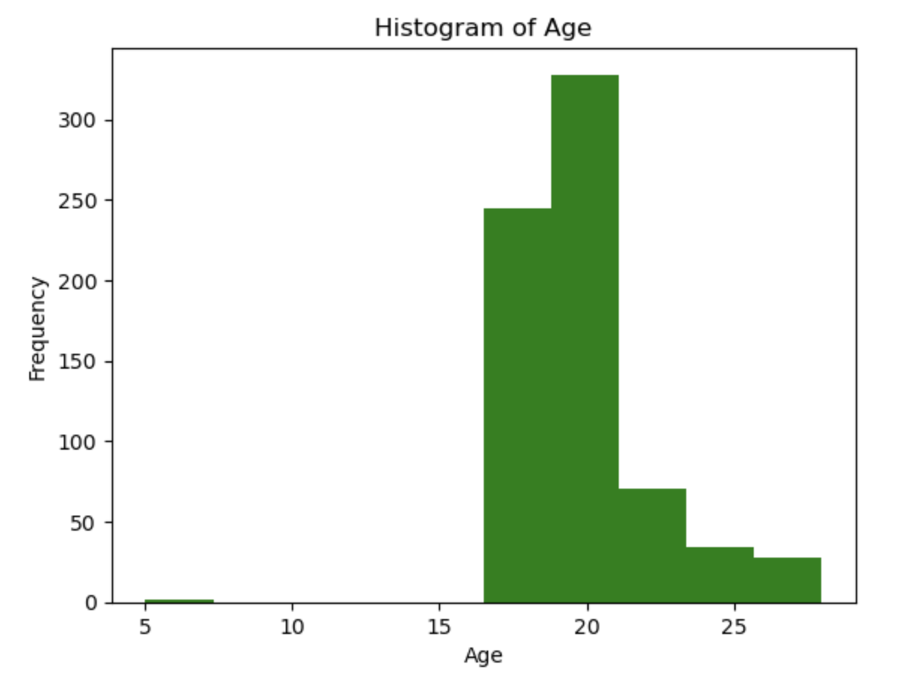
Data Analysis

Slide 10
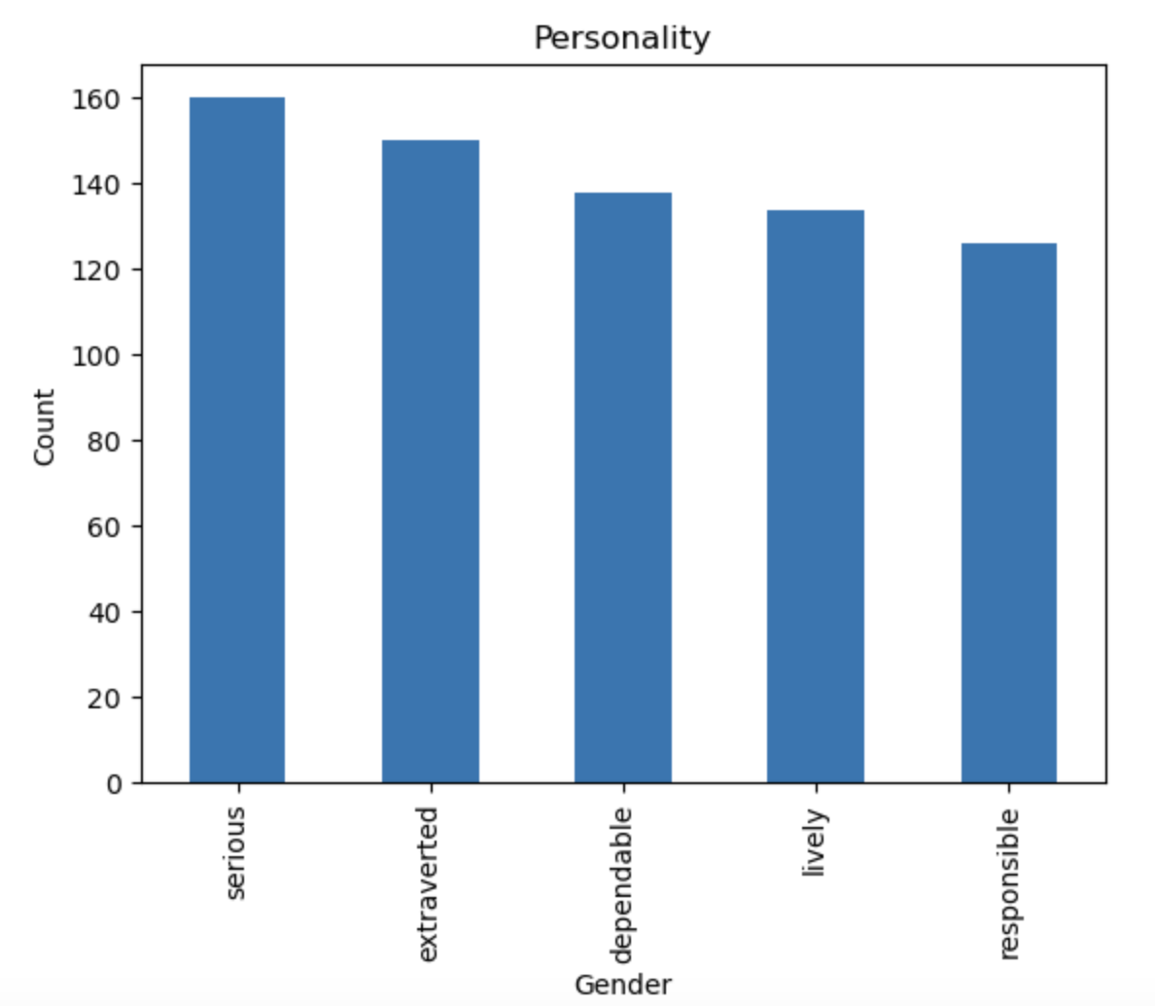
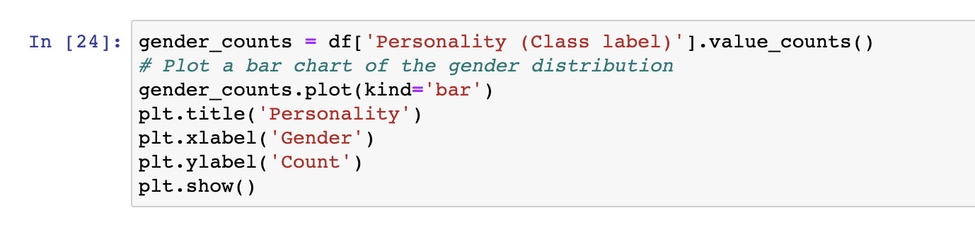

Slide 11
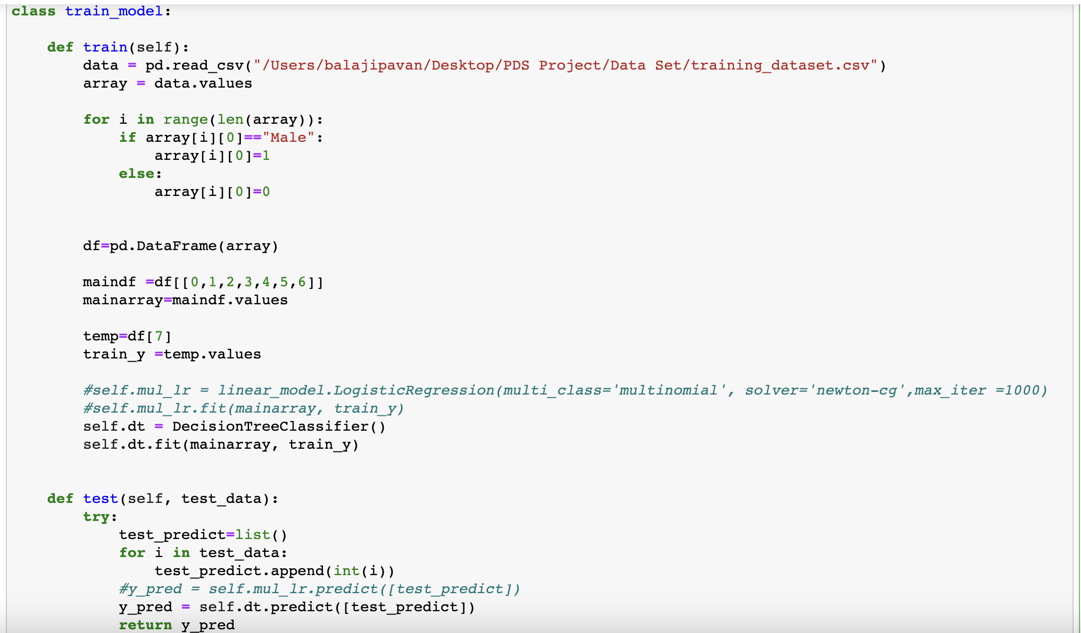
Model Training
We have trained our data using logistic regression , Decision Tree .
The model fitted with the test data.
We made predictions using the test data.
We have split the data Train data – 80% Test data – 20%

Slide 12
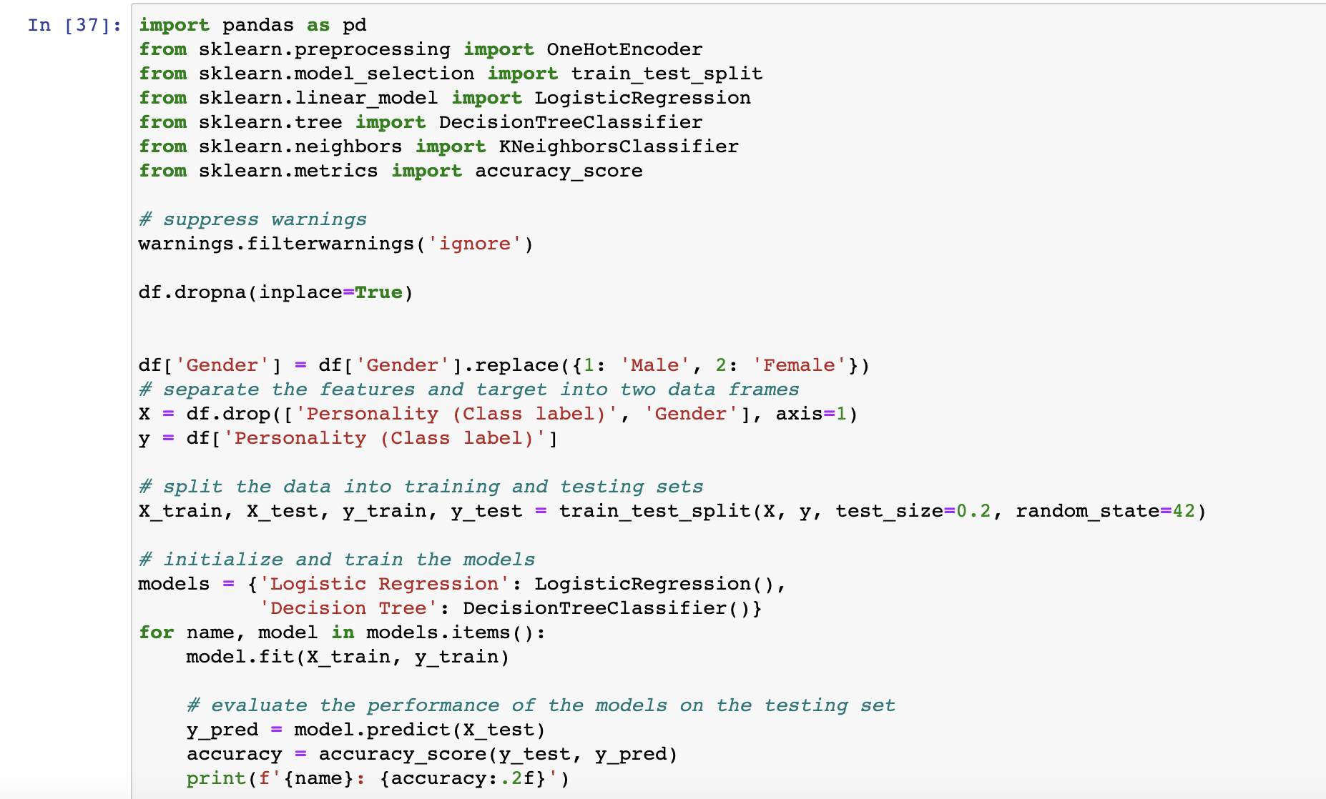

Slide 13
Py res parser
Extract name
Extract email
Extract mobile numbers
Extract skills
Extract total experience
Extract college name
Extract degree
Extract designation
Extract company names

Slide 14
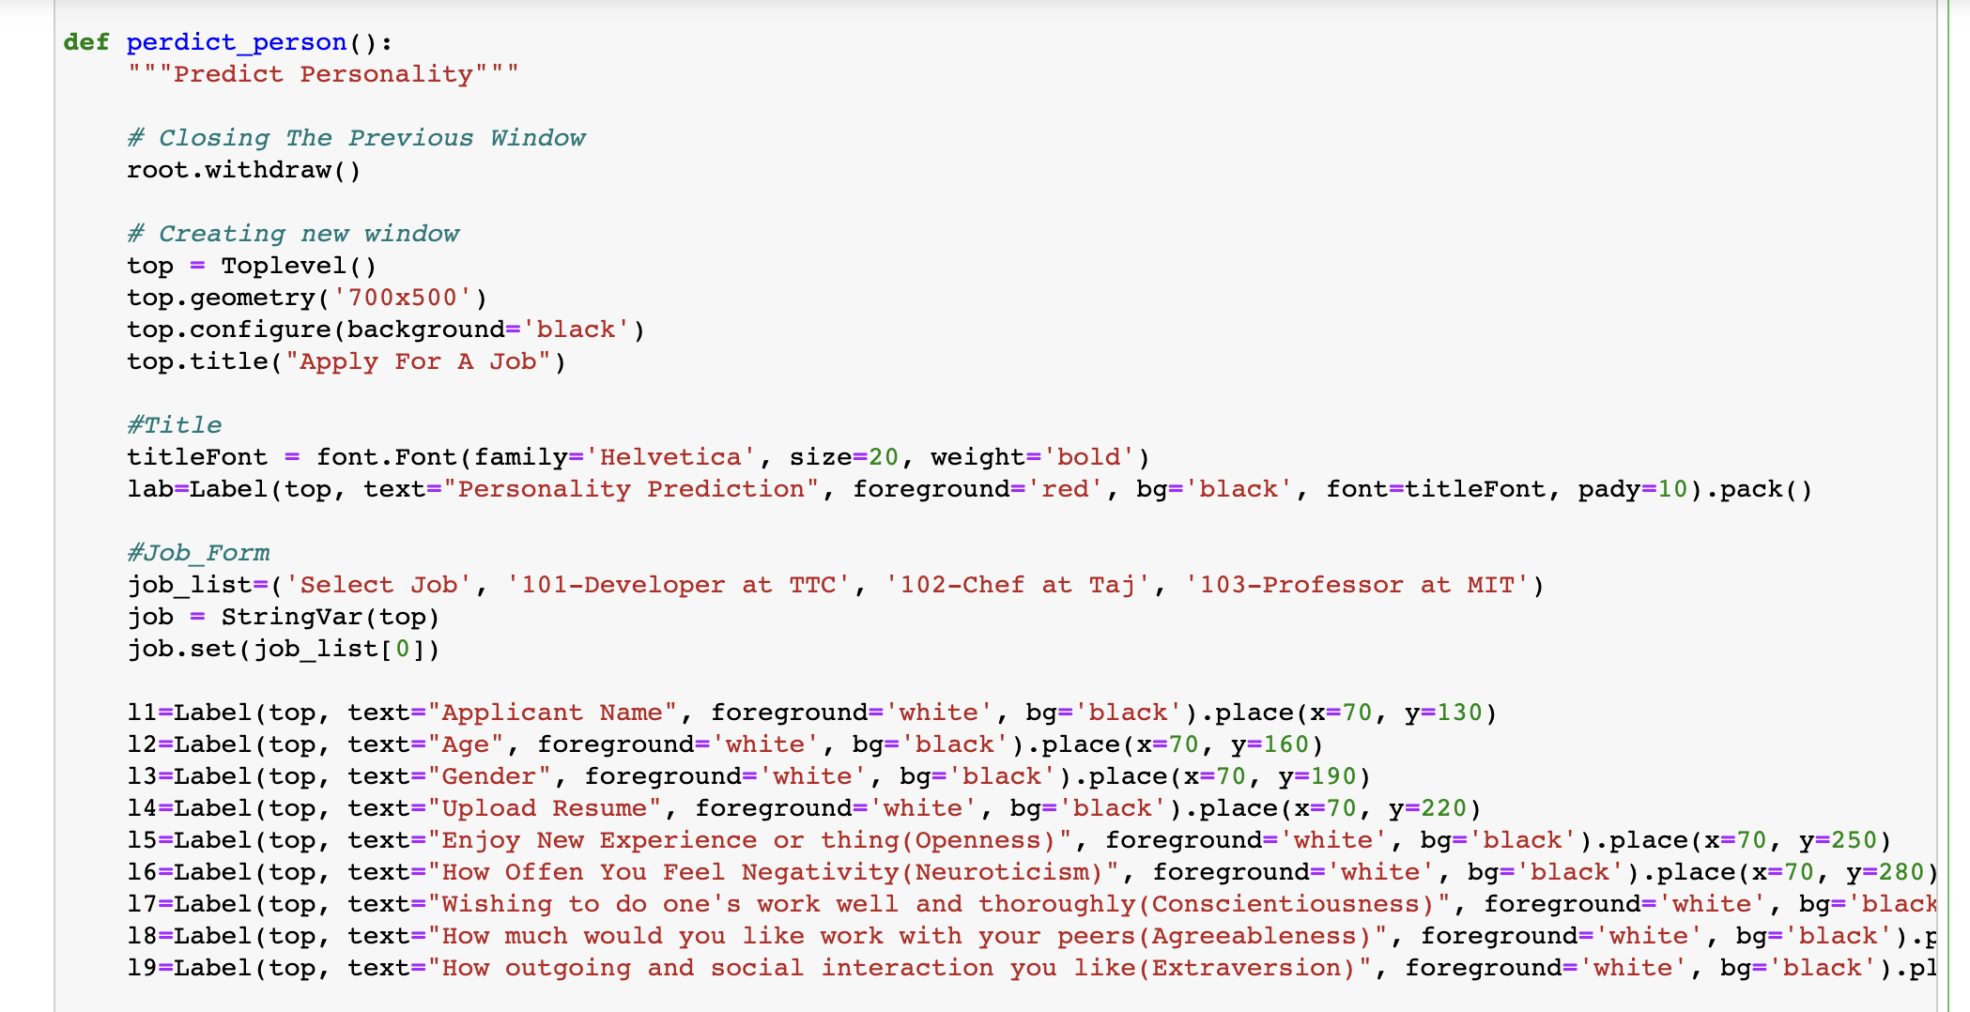
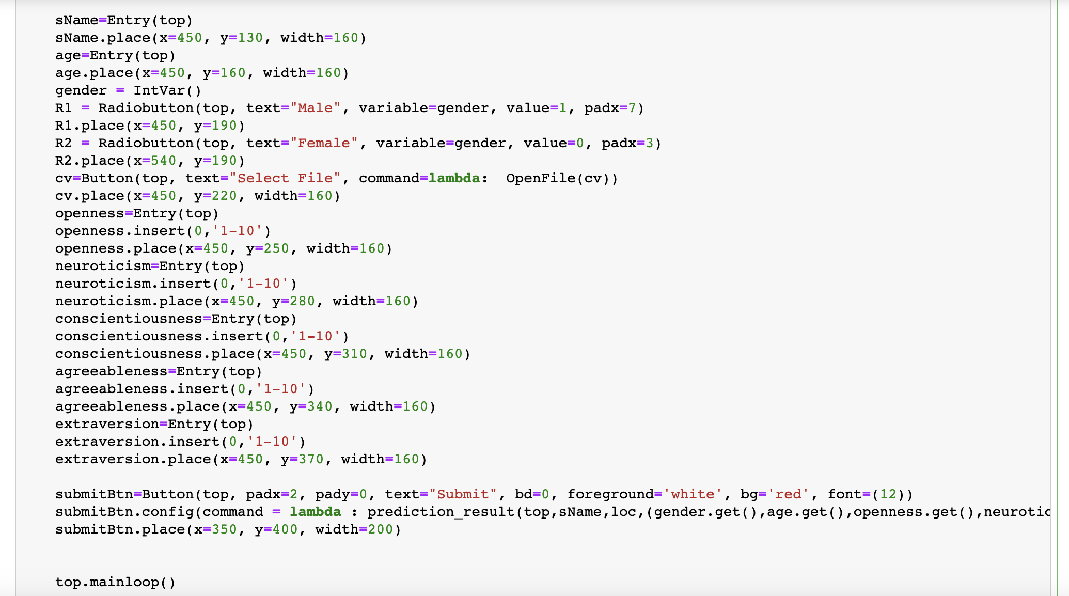
tkinter -- Python interface to Tk
The tkinter package (“Tk interface”) is the standard Python interface to the Tk GUI toolkit. Both Tk and tkinter are available on most Unix platforms, including macOS, as well as on Windows systems.

Slide 15
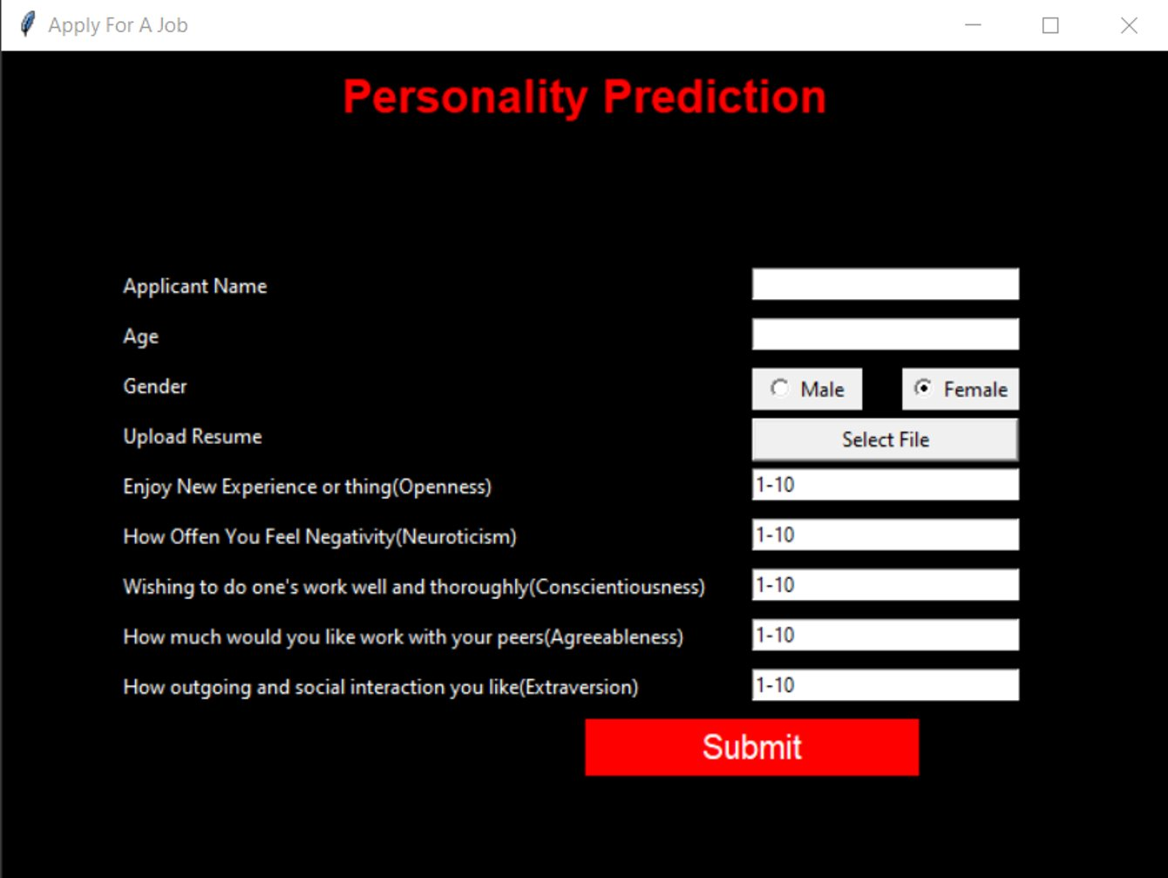

Slide 16
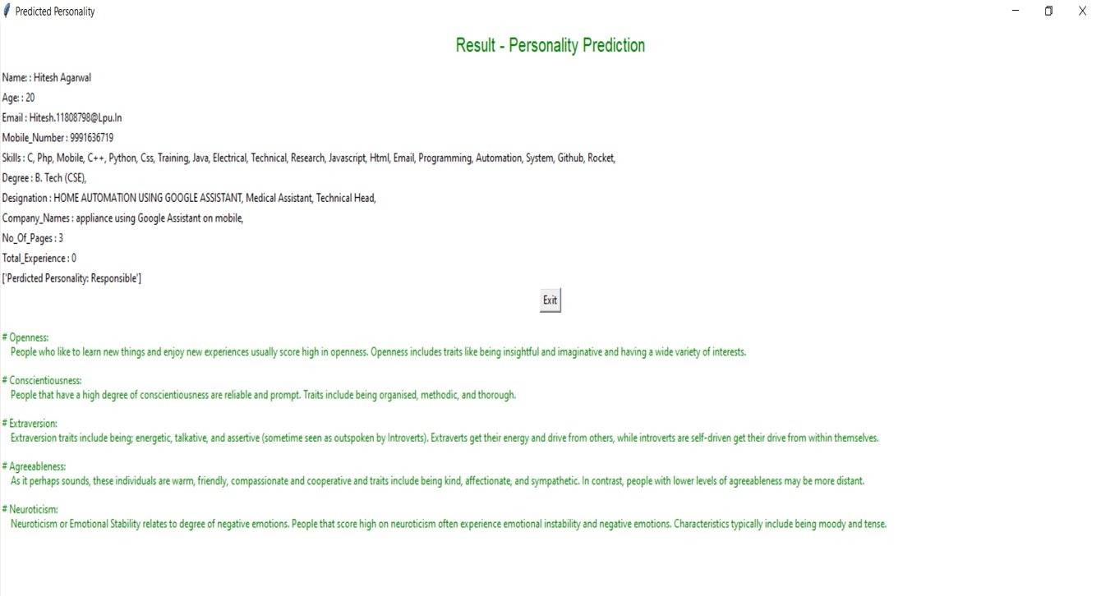

Slide 17
Reffered Research Papers :
1."Personality Prediction System Through CV Analysis", International Journal of Science & Engineering Development Research (www.ijsdr.org), ISSN:2455-2631, Vol.4, Issue 4, page no.139 - 142, April-2019
2. L D. van der, J te Nijenhuis, et al. The General Factor of Personality: A meta-analysis of Big Five intercorrelations and a criterion-related validity study. Journal of Research in Personality 2010; 44: 315-327.
3. I Ilke, W Peter, Personality and Job Engagement. Journal of Personnel Psychology 2011; 10: 177-181

Slide 18


